Slide 1

Cyclistic Bike-Share Case Study
How member and casual rider behavior differs
Tools: SQL (BigQuery), Excel

Slide 2
Business Task
Identify how members and casual riders use Cyclistic bikes differently.
Use insights to design conversion-focused marketing strategies.

Slide 3
Data & Tools
2019 Cyclistic trip data (Q1–Q4)
3.8M rides, trip-level records
Fields: Start/End, Duration, Stations, User type

Slide 4
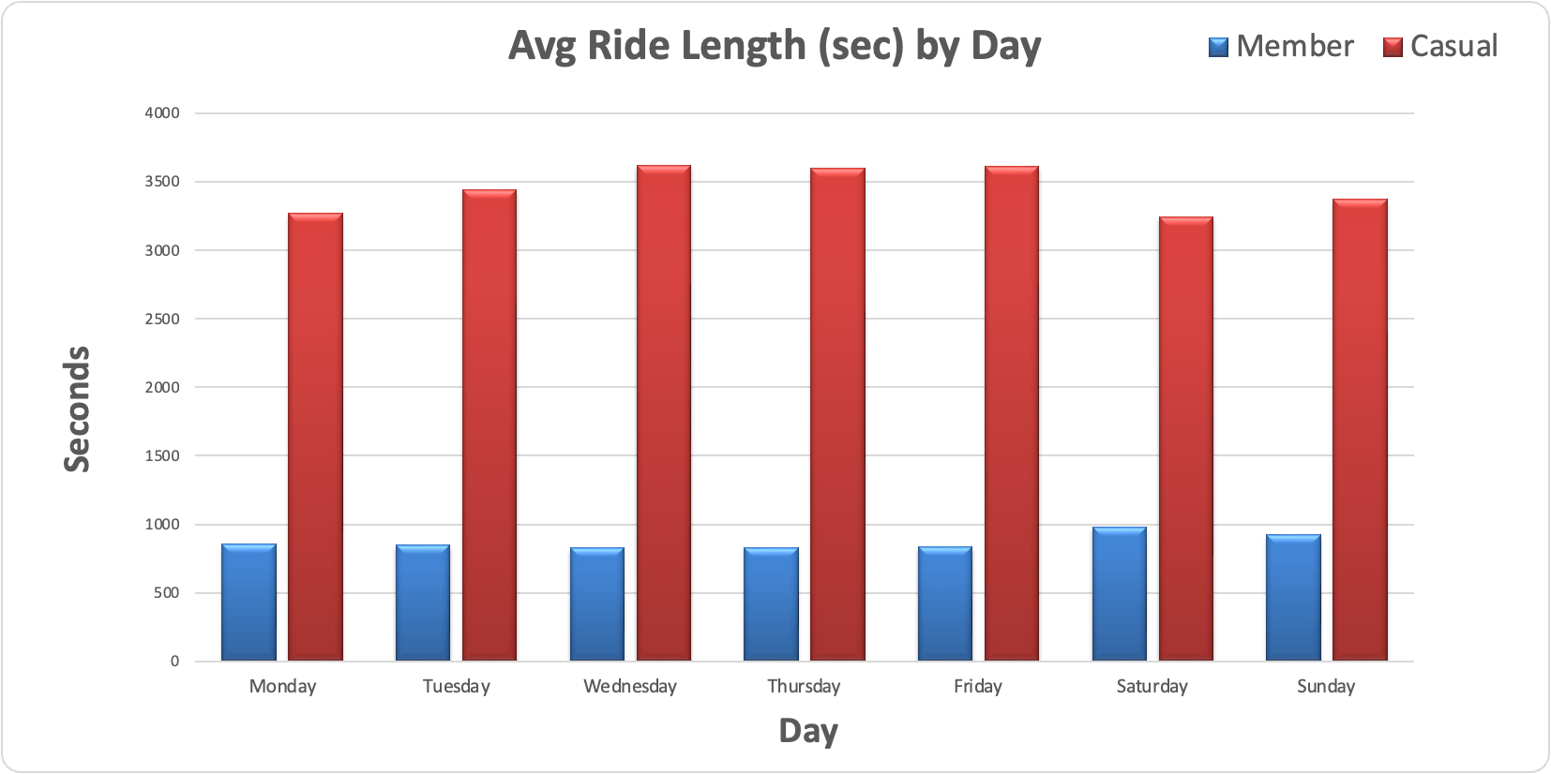
Key Findings (Behavior)
Members ride more often but for shorter trips (avg 14.3 min).
Casual riders take much longer trips (avg 57.0 min).
Weekend share: 18.5% member vs 43.0% casual.
Round-trip rate: 1.62% member vs 11.88% casual.
Long rides >30 min: 5.7% member vs 41.0% casual.

Slide 5
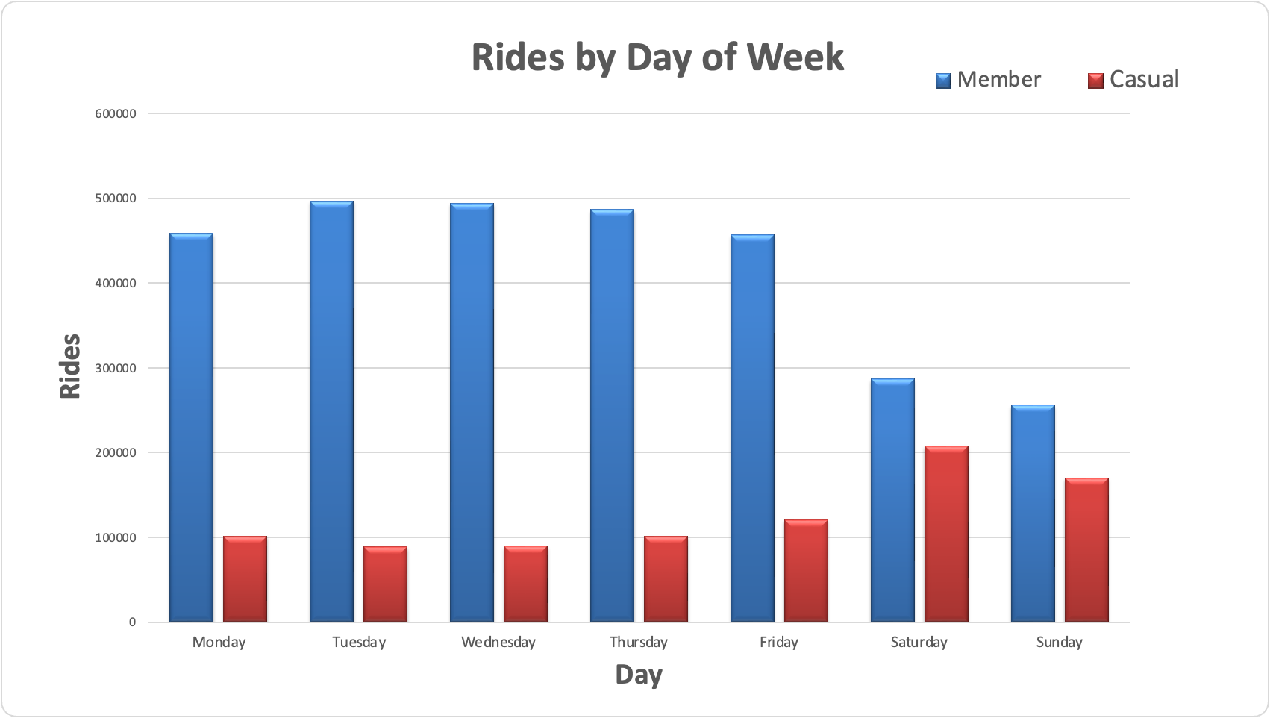
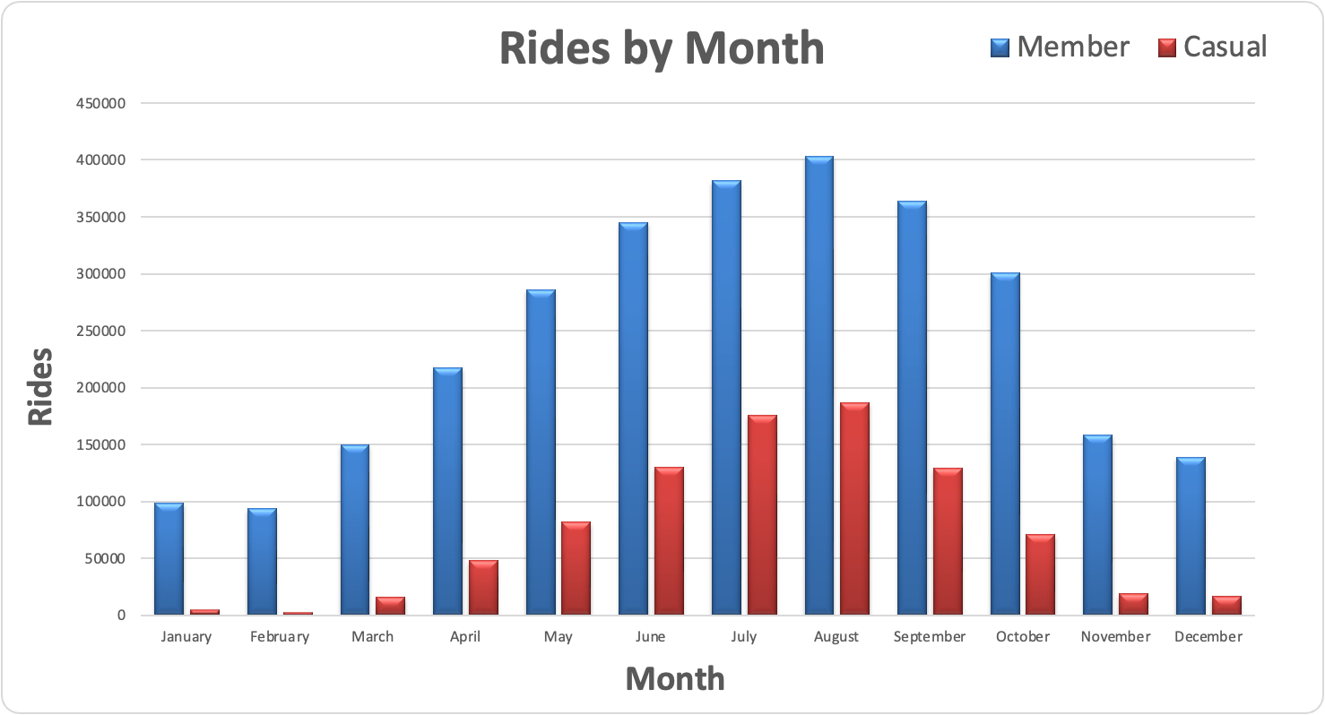
Time Patterns

Slide 6
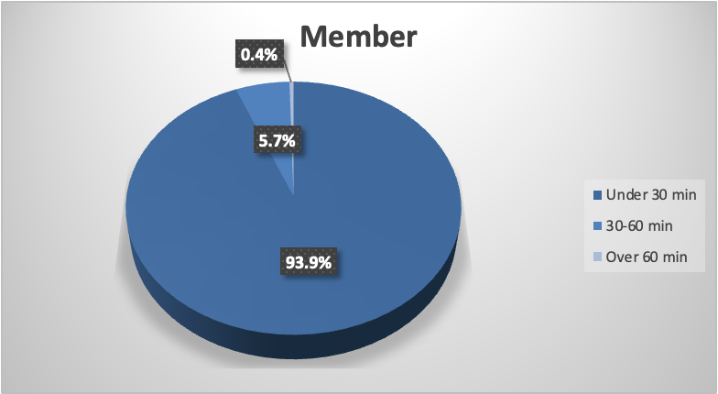
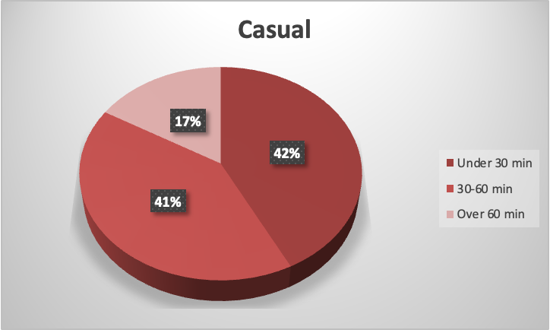
Differences in Trip Lengths

Slide 7
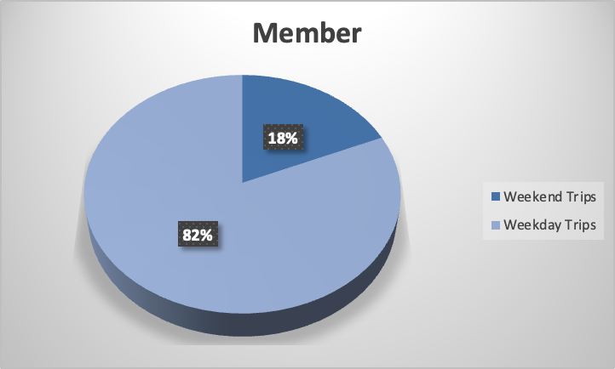
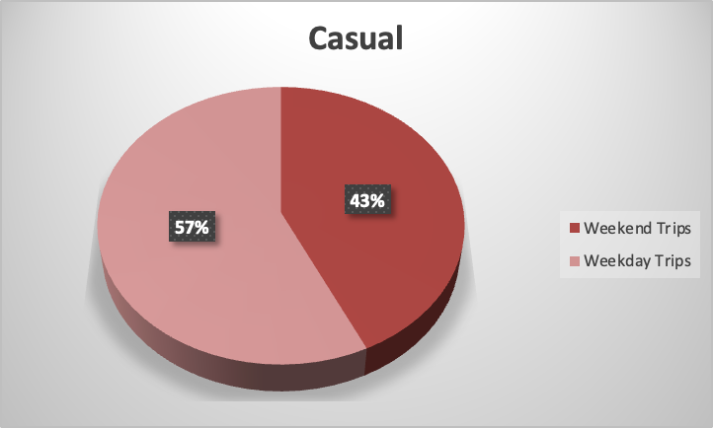
Differences in Trip Days

Slide 8
Recommendations (Top 3)
Weekend Explorer membership trials for casual riders.
Commute-focused messaging during weekday peaks.
Station-targeted offers at casual hotspots (e.g., Streeter Dr & Grand Ave).

Slide 9
Next Steps
Pilot conversion campaigns at top casual stations.
Measure conversion lift over 4–8 weeks.
Add weather and event data for deeper targeting.

